Slide 1

Machine Translation
Yuqian Zhang
yz6572@nyu.edu

Slide 2
Content
Problem description
Dataset
Methodology
seq2seq model
GRU (RNN; LSTM)
Attention
Framework design
Detailed outline for my code
Results
Loss curve analysis
Attention visualization analysis
Possible extensions

Slide 3

Problem description
Machine learning (MT)
But ISN’T always good
Applied areas

Slide 4
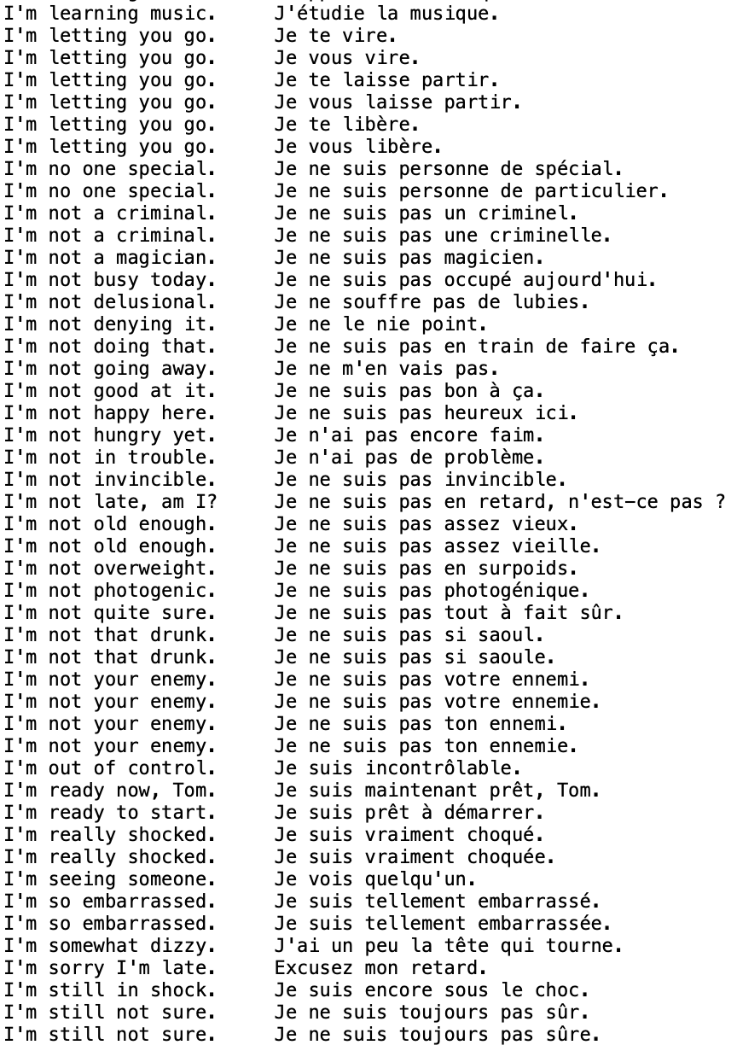
Dataset
a French/English parallel text
containing over 22.5 million sentences in both French and English
https://www.kaggle.com/datasets/anubhav3377/machinetranslationengfra
Fig1. Part of the dataset

Slide 5
Methodology
seq2seq task
SOS: starting character
EOS: ending character
E.g.: the path of “I love you”
If EOS:
End
Else:
Continue
Also a classification task back to decoded answer
The highest probability

Slide 6
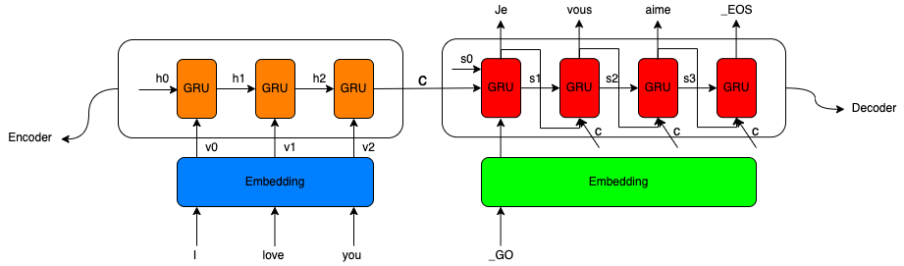

seq2seq model
Structure:
Encoder
Decoder
Steps: E.g. I love you → Je vous aime.
Internal implementation
GRU (will be introduced later)
Fig2. Architecture of seq2seq model

Slide 7
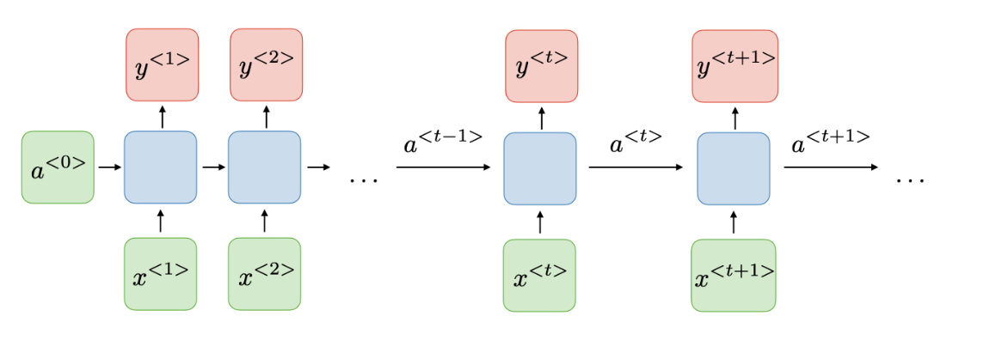
Architecture of a traditional RNN
Fig3. General structure of RNN
Advantages and drawbacks

Slide 8

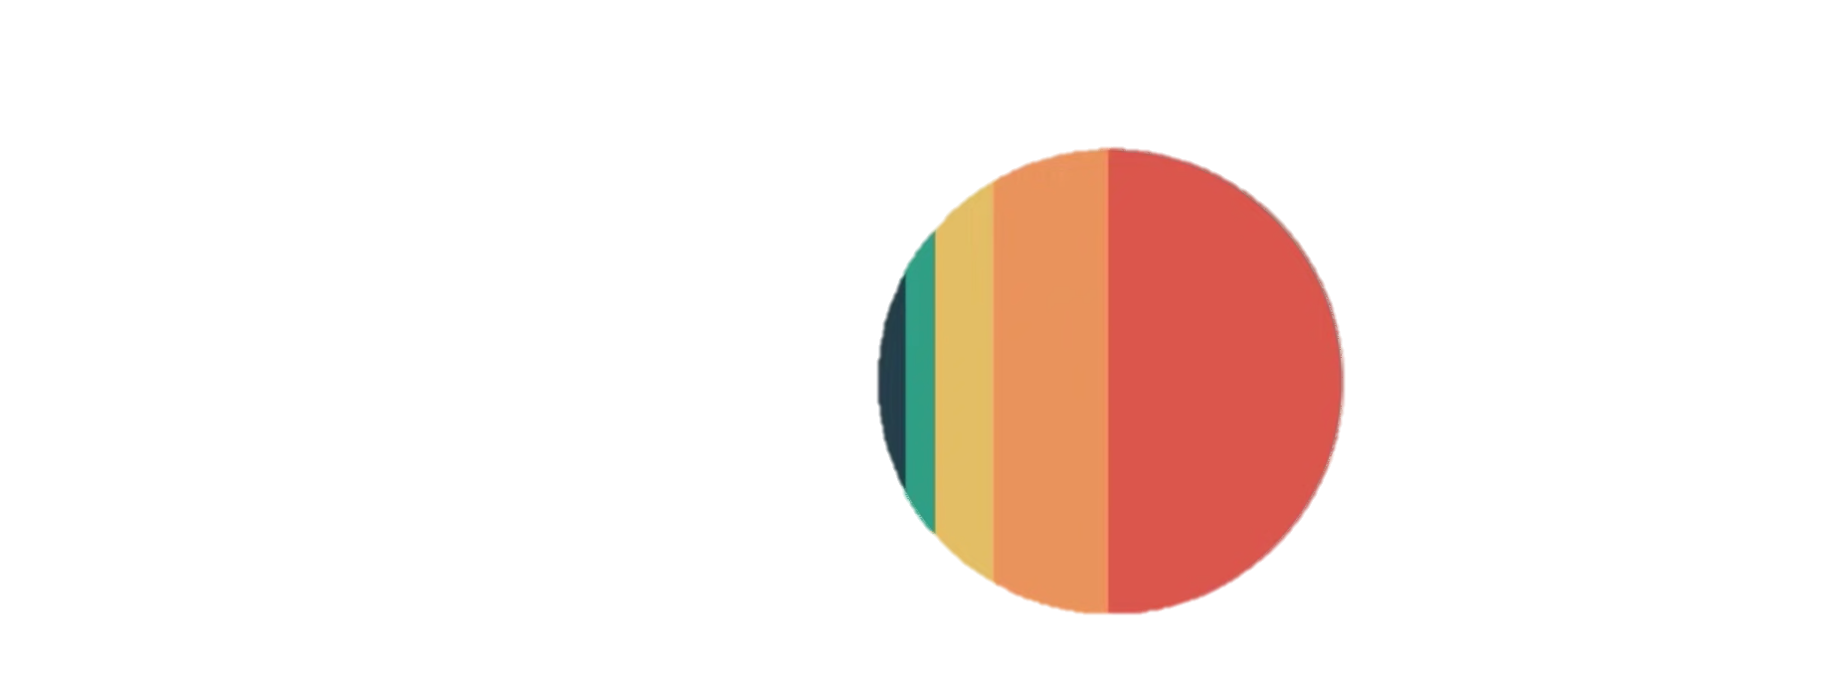
Recurrent Neural Networks (RNN)
Fig5. Final hidden state of the RNN
Fig4. How RNN passes words

Slide 9
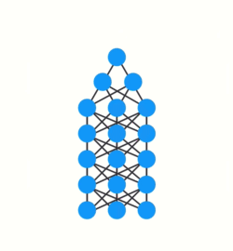
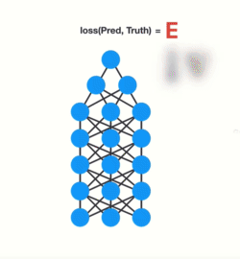
WHY NOT RNN: Vanishing gradient problem
What is short term memory
Gradient update rule
Small value won’t contribute so much change
backpropagation
Fig6. Gradients shrink as it back-propagates down

Slide 10
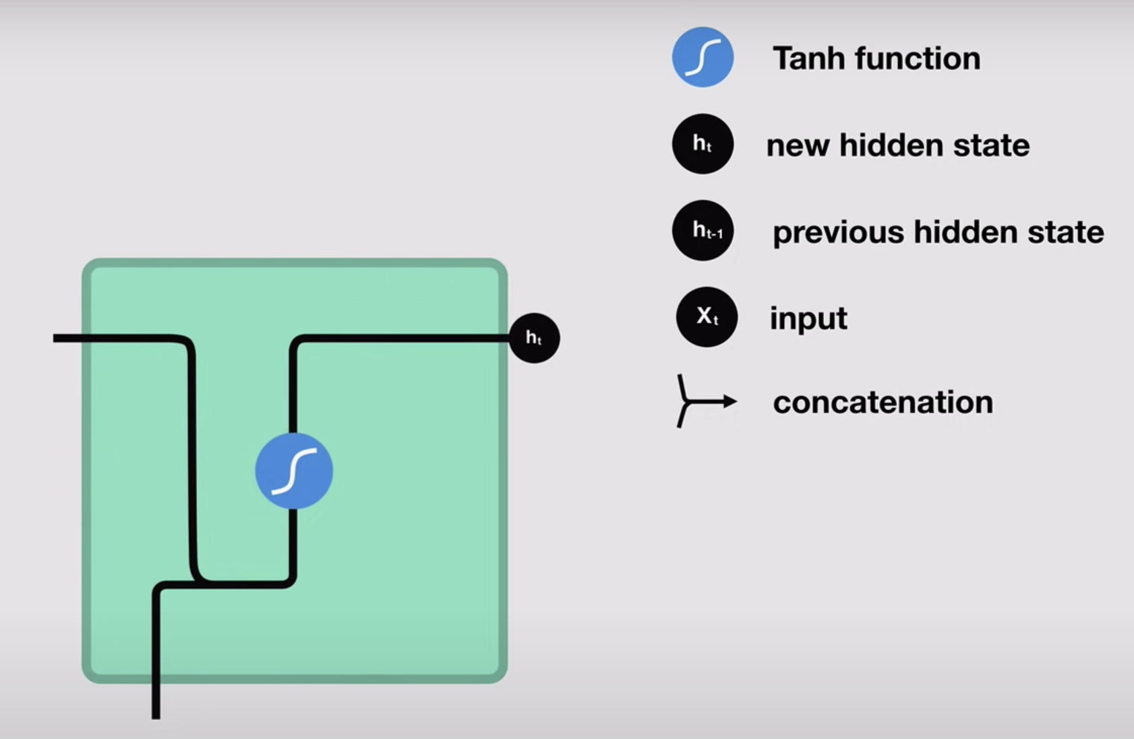
Vanilla Recurrent Neural Networks
Fig8. Vanilla Recurrent Neural Networks

Slide 11
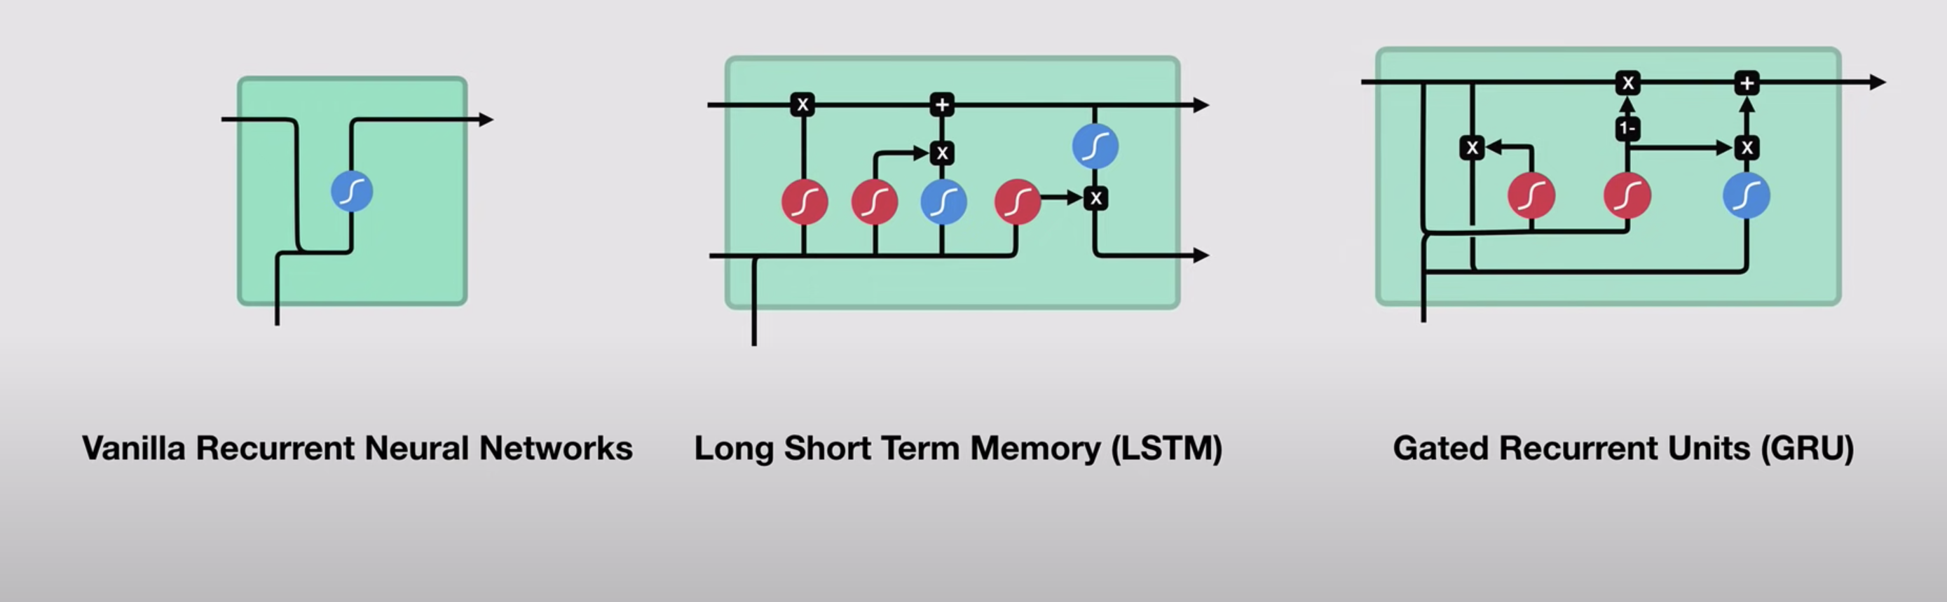
GRU
Recurrent Neural Networks (RNN)
Gated Recurrent Unit (GRU)
Why we need GRU
What is GRU
What is Long Short-Term Memory units (LSTM)
Comparison
Fig9. Overview of three models

Slide 12
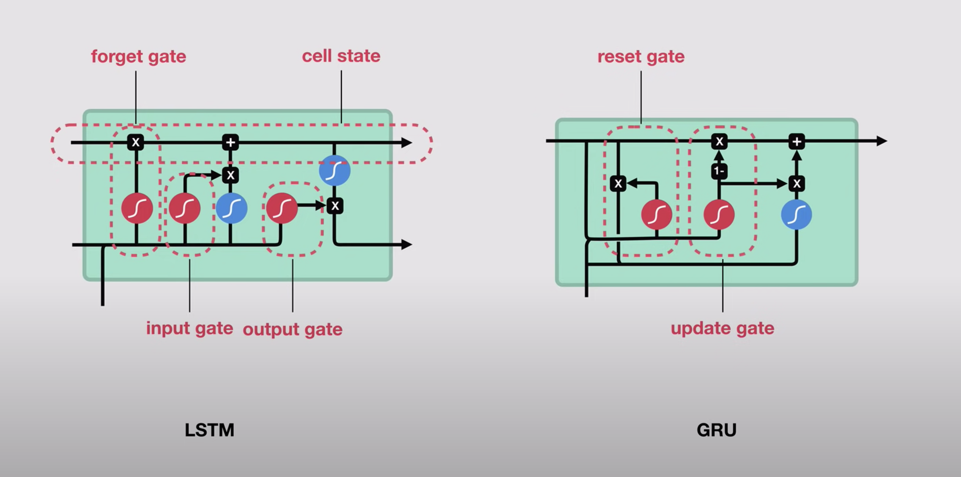
LSTM and GRU
Types of gates and each function
Fig10: LSTM and GRU

Slide 13
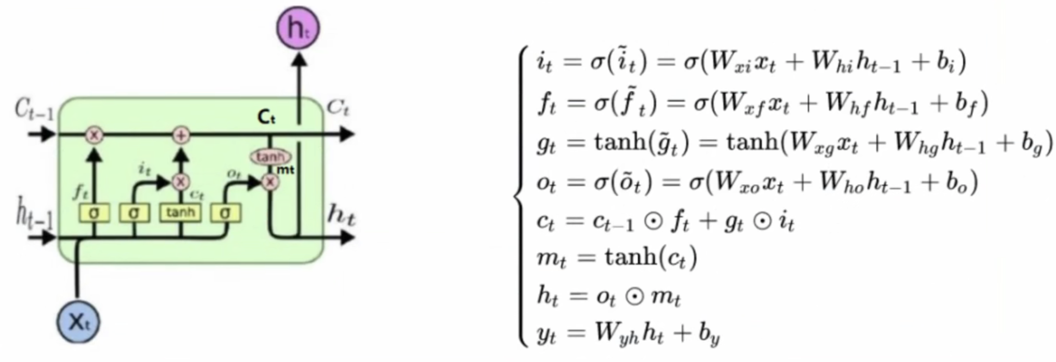
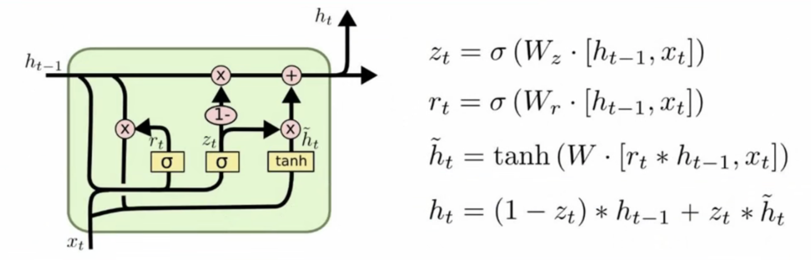
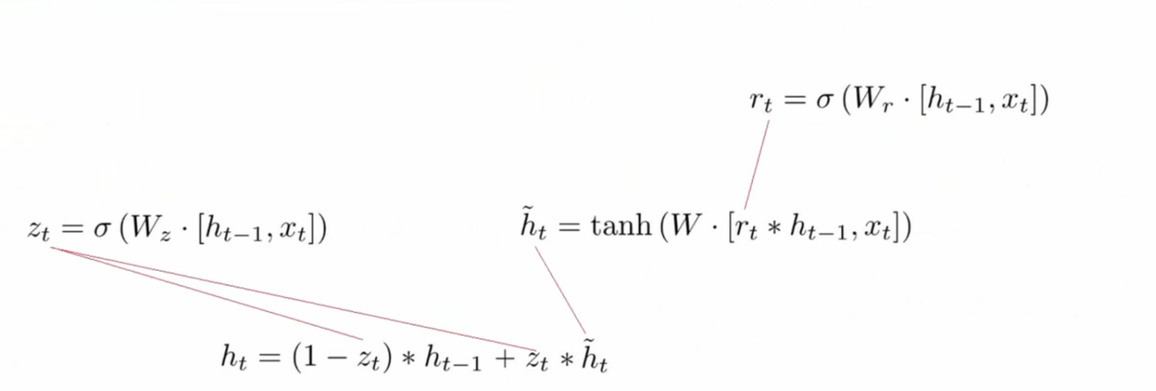
Details of the differences
LSTM
Fig11. Details of LSTM model
GRU
Fig12. Details of GRU model
Fig13. Calculating path

Slide 14
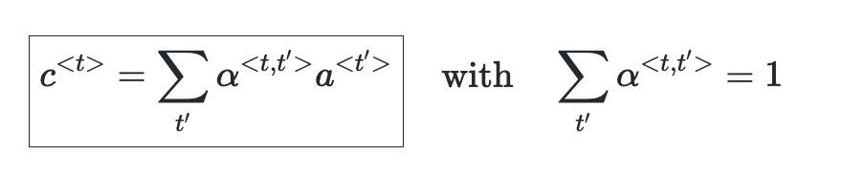
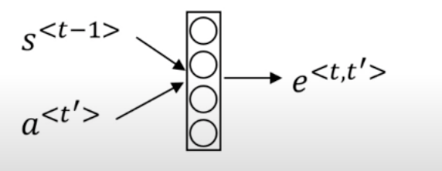
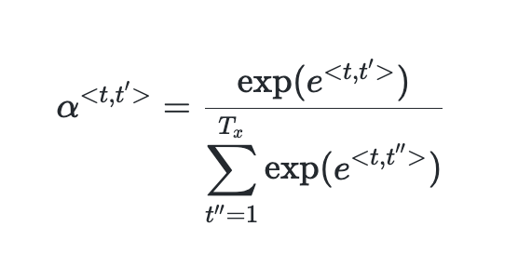
Attention
What is attention
QKV theory (self-attention)
Downsides
Quadratic time
Attention Model
Fig14. Attention model
Attention Weight
Fig16. Simple neural network
Fig15. Attention weight

Slide 15
Framework design
GRU-based seq2seq model architecture to implement the translation process:
Importing the required toolkit
Process the data in the persistence file to meet the model training requirements
Build the GRU-based encoder and decoder
Build the model training function and perform the training
Build the model evaluation function and perform testing and Attention effect analysis

Slide 16
Detailed outline for my code
Import package
Data processing
Mapping words in a given language to values
Normalizing string
Loading the data from the persistence file into memory, and instantiating the Lang class
Filtering out the language pairs that meet the requirements
Integrating the data preparation function shown above, and mapping the language pairs to values using the Lang class
Transform the language pairs into the tensor needed for model input
Building GRU-based encoders and decoders
Building a GRU-based encoder
Building a GRU-based decoder
Building decoder based on GRU and Attention
Construct model training function and perform training
Constructing training functions
Constructing time calculation functions
Calling training functions and printing logs and graphing
Construct model evaluation functions and perform testing and Attention effect analysis
Constructing model evaluation functions
Randomly select a specified amount of data for evaluation
Visualizing Attention tensor

Slide 17
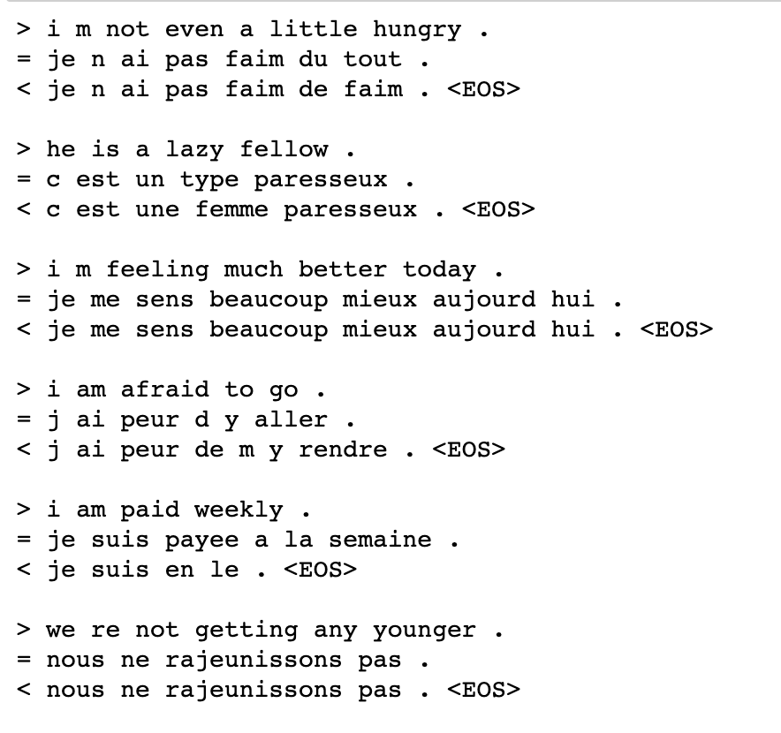
Results
How we get the evaluation?
Attention visualization analysis
How to reduce the loss?
Fig17. Results_1
> represents input
= represents the correct output
< represents the output of the model

Slide 18
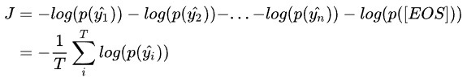
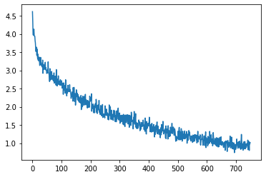
Loss curve analysis
With cross entropy
the model is converging
Fig19. Loss curve
Fig18. Loss curve result

Slide 19
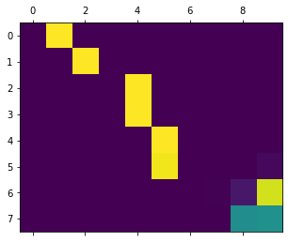
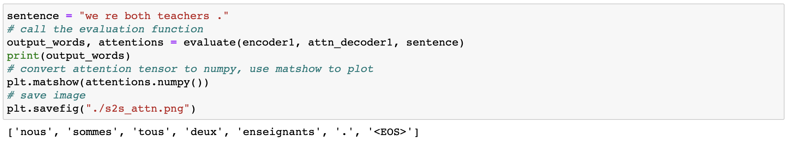
Attention visualization analysis
The meaning of coordinates
Color:
the lighter the color, the greater the influence
Why we need it
Example:
Fig20. Attention visualization
Fig21. example for visulization

Slide 20
Possible extensions
Reflection:
Especially in random sampling detection – focus on the training of lexical association distribution
BERT model
Multi-task learning

Slide 21
https://lokalise.com/blog/machine-translation-software/

